Slide 1

AudiO-VISUAL SPEECH RECOGNITION
GROUP MEMBERS : TEJASWI KOTTAKKI - 2010030088
HARIKA NETHI - 2010030119
SHREYA CHINTAWAR - 2010030155
AMRUTHA VARSHINI - 2010030009
GUIDE
DR.ARPITA GUPTA

Slide 2
OUTLINE
Problem statement
Motivation
Objective
Literature Survey
Dataset
Techniques
Conclusion
References
AUDIO-VISUAL SPEECH RECOGNITION 04-02-2022 2

Slide 3
Problem statement
Communicating with hearing-impaired people is a little more demanding than speaking to a normal person.
Speech impaired people or people having low vocal range, find it difficult to communicate, as other people might not be able to understand.
Hearing and speech impairments can affect anyone, both children and adults.
AUDIO-VISUAL SPEECH RECOGNITION 04-02-2022 3

Slide 4
MOTIVATION
Speech reading helps to improve speech perception.
Hearing impaired people rely on lip reading for understanding the speech.
Audio - Visual speech recognition could positively impact the lives of hundreds of thousands of patients with speech and hearing impairments.
AUDIO-VISUAL SPEECH RECOGNITION 04-02-2022 4

Slide 5
OBJECTIVE
Assistive technology on speech-to-text conversion.
Lip reading architecture capture visual speech recognition
Speaker recognition under noisy and unconstrained conditions
AUDIO-VISUAL SPEECH RECOGNITION 04-02-2022 5

Slide 6
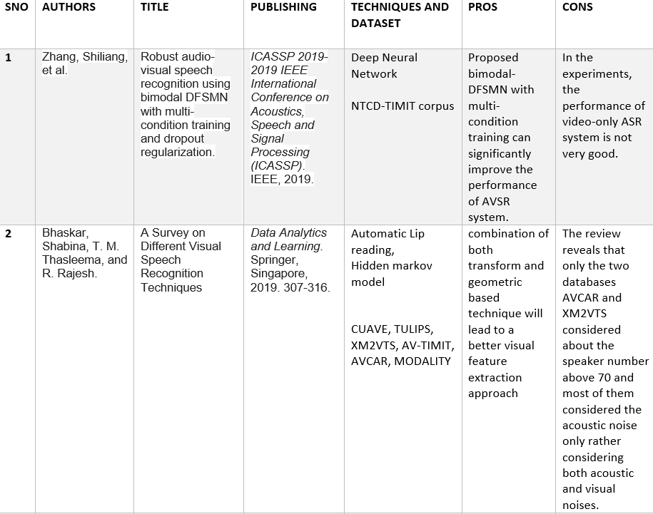
LITERATURE SURVEY
AUDIO-VISUAL SPEECH RECOGNITION 04-02-2022 6

Slide 7
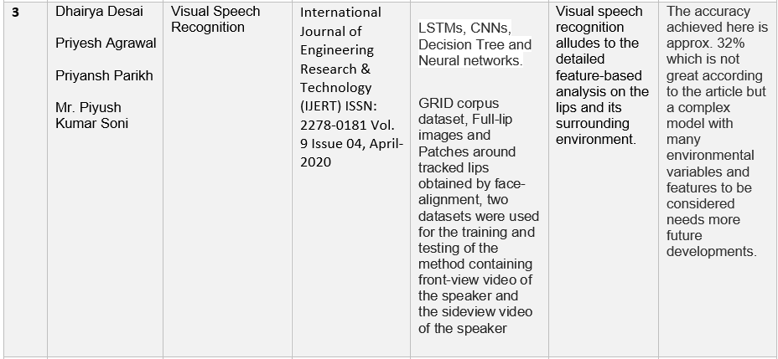
AUDIO-VISUAL SPEECH RECOGNITION 04-02-2022 7

Slide 8
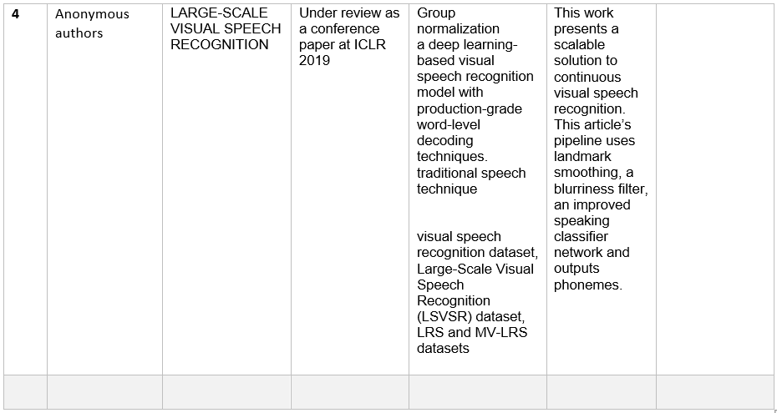
AUDIO-VISUAL SPEECH RECOGNITION 04-02-2022 8

Slide 9
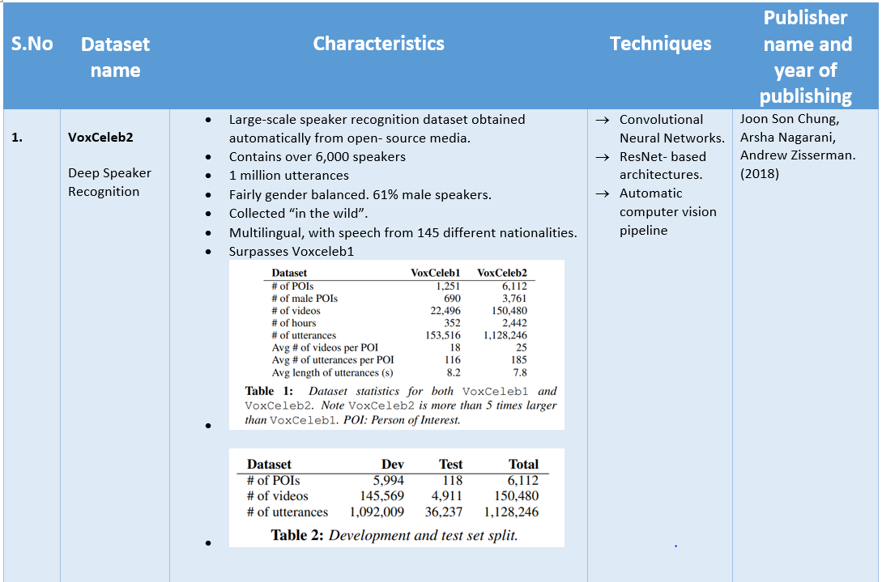
DATASET
AUDIO-VISUAL SPEECH RECOGNITION 04-02-2022 9

Slide 10
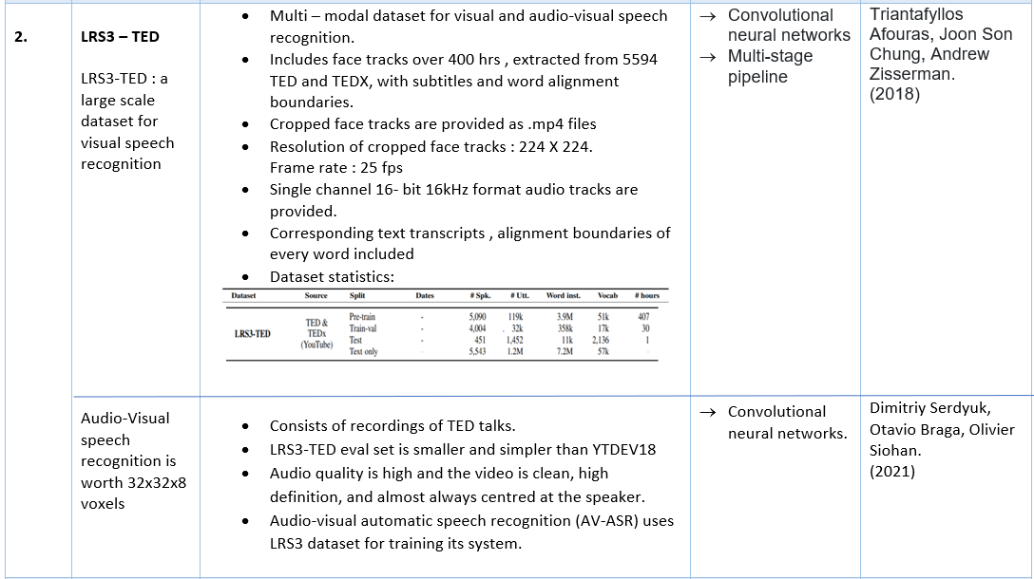
AUDIO-VISUAL SPEECH RECOGNITION 04-02-2022 10

Slide 11
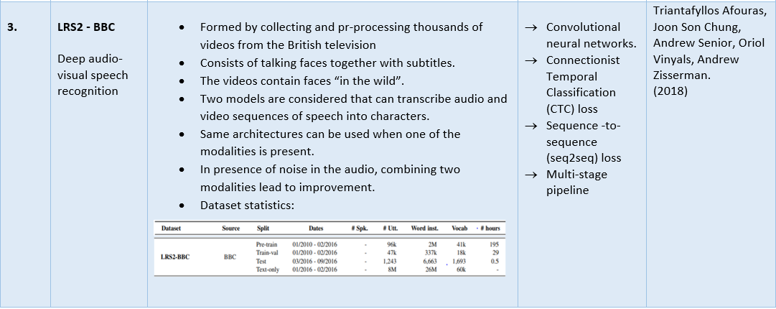
AUDIO-VISUAL SPEECH RECOGNITION 04-02-2022 11

Slide 12
Techniques
Convolutional Neural Networks :
Convolutional neural networks are distinguished from other neural networks by their superior performance with image, speech, or audio signal inputs.
ResNet – based architecture :
The residual-network (ResNet) architecture [10] is similar to a standard multi-layer CNN, but with added skip connections such that the layers add residuals to an identity mapping on the channel outputs.
Automatic computer vision :
In order to extract reliable, real-time, and quantitative features from images collected by these sensors, a robust and automated image processing pipeline is required.
AUDIO-VISUAL SPEECH RECOGNITION 04-02-2022 12

Slide 13
conclusion
This technology provides an alternative way of communication (i.e. Visual communication) for people with hearing or speech impaired problems.
Through this work we can recognize phrases and sentences being spoken by a talking face, with or without the audio.
We are exploring different datasets to create our own new working model.
AUDIO-VISUAL SPEECH RECOGNITION 04-02-2022 13

Slide 14
references
Zhang, Shiliang, Ming Lei, Bin Ma, and Lei Xie. "Robust audio-visual speech recognition using bimodal DFSMN with multi-condition training and dropout regularization." In ICASSP 2019-2019 IEEE international conference on acoustics, speech and signal processing (ICASSP), pp. 6570-6574. IEEE, 2019.
Bhaskar, Shabina, T. M. Thasleema, and R. Rajesh. "A Survey on Different Visual Speech Recognition Techniques." In Data Analytics and Learning, pp. 307-316. Springer, Singapore, 2019.
Desai, Dhairya, Priyesh Agrawal, Priyansh Parikh, and Mr. Piyush Kumar Soni. "Visual Speech Recognition." International Journal of Engineering Research & Technology (IJERT) 9, no. 04 (2020).
Shillingford, Brendan, Yannis Assael, Matthew W. Hoffman, Thomas Paine, Cían Hughes, Utsav Prabhu, Hank Liao et al. "Large-scale visual speech recognition." arXiv preprint arXiv:1807.05162 (2018)
AUDIO-VISUAL SPEECH RECOGNITION 04-02-2022 14

Slide 15
Chung, Joon Son, Arsha Nagrani, and Andrew Zisserman. "Voxceleb2: Deep speaker recognition." arXiv preprint arXiv:1806.05622 (2018).
Afouras, Triantafyllos, Joon Son Chung, and Andrew Zisserman. "LRS3-TED: a large-scale dataset for visual speech recognition." arXiv preprint arXiv:1809.00496 (2018).
Serdyuk, Dmitriy, Otavio Braga, and Olivier Siohan. "Audio-Visual Speech Recognition is Worth 32 x 32 x 8 Voxels." arXiv preprint arXiv:2109.09536 (2021).
Afouras, Triantafyllos, Joon Son Chung, Andrew Senior, Oriol Vinyals, and Andrew Zisserman. "Deep audio-visual speech recognition." IEEE transactions on pattern analysis and machine intelligence (2018).
AUDIO-VISUAL SPEECH RECOGNITION 04-02-2022 15

Slide 16
SUGGESTIONS
AUDIO-VISUAL SPEECH RECOGNITION 04-02-2022 16

